Slide 1



CHAITANYA BHARATHI INSTITUTE OF TECHNOLOGY
Department of Artificial Intelligence and Data Science
MINI PROJECT - II
LAPTOP PRICE PREDICTION
DESHAMONI SREE HARSHA - 160121771100
KAMUNI AKHIL - 160121771105

Slide 2

CONTENT
01
ABSTRACT
02
EXISTING SYSTEM
03
PROBLEM STATEMENT
04
GOALS AND OBJECTIVES
05
PROPOSED SYSTEM
06
METHODOLOGY
07
PACKAGES AND MODULES
08
ALGORITHMS USED
09
OUTPUT AND RESULTS
10
CONCLUSION
11
REFERENCES

Slide 3




ABSTRACT
In today's world, laptops have become an essential tool for personal and professional use. With the vast range of laptops available in the market, it can be challenging to determine their prices.
The objective of this project is to develop a machine learning model that can predict the price of a laptop based on its specifications.

Slide 4



EXISTING SYSTEMS
Before the development of laptop price prediction models, the pricing of laptops was done using traditional methods such as cost-plus pricing, value-based pricing, competition based pricing, and psychological pricing.
Cost-plus pricing involved adding a markup to the manufacturing cost of the laptop to determine the selling price.
Value-based pricing involved setting the price based on the perceived value of the laptop to the customer.

Slide 5


PROBLEM STATEMENT
It is commonly known that laptop use is widespread among educated people and students alike.
In order to buy a laptop, everybody is familiar with the confusion that arises when they are trying to determine their budget and the configuration they need.
Problem
As a result, this became a problem that needed to be resolved to move forward.

Slide 6





GOALS AND OBJECTIVES
GOAL
OBJECTIVES
To Build a Machine Learning Model to predict the price of the laptop based on their specifications
To Optimize the model performance by using feature engineering and various machine learning algorithms

Slide 7
PROPOSED SYSTEM
To achieve this, we will collect a dataset consisting of various features of laptops.
We will use various machine learning algorithms such as Linear Regression, Random Forest, and XG Boost to train our model on the dataset.
SYSTEM
After training the model, we will evaluate its performance by using various evaluation metrics such as mean squared error (MSE) and
R-squared score.

Slide 8
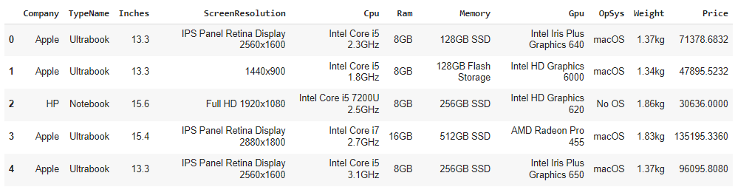
DATA SET

Slide 9
METHODOLOGY
DATA CLEANING
EXPLORARTORY DATA ANALYSIS(EDA)
FEATURE ENGINEERING
MODELLING
WEBSITE / USER INTERFACE

Slide 10
PACKAGES AND MODULES
Data Cleaning
EDA
Matplotlib
Stats
Pandas
Numpy
Feature Engineering
Modelling
Scikitlearn
Pipeline
sklearn.LabelEncoder
sklearn.StandardScaler
Website
Streamlit
Pickle

Slide 11
ALGORITHMS USED
Linear Regression
Ridge Regression
Lasso Regression
Decision Tree Regression
SVM Regression
K Nearest Neighbors
Random Forest Regression
Extra Trees Regression
Ada Boost Regression
Voting Regression
Stacking Regression

Slide 12
ACCURACY
89%
Best accuracy was achieved by Random Forest Regression.
The R2 score of Voting regressor is 0.88735
The Mean Absolute Error of Voting Regressor is 0.15862

Slide 13
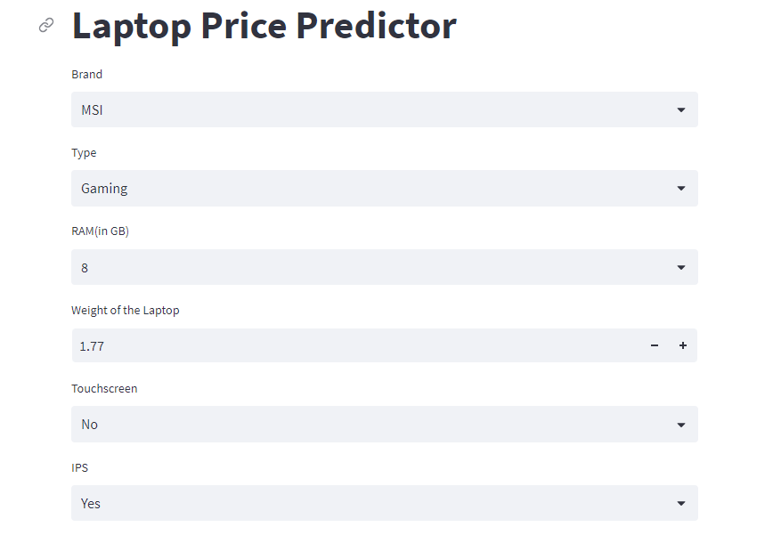
OUTPUTS

Slide 14
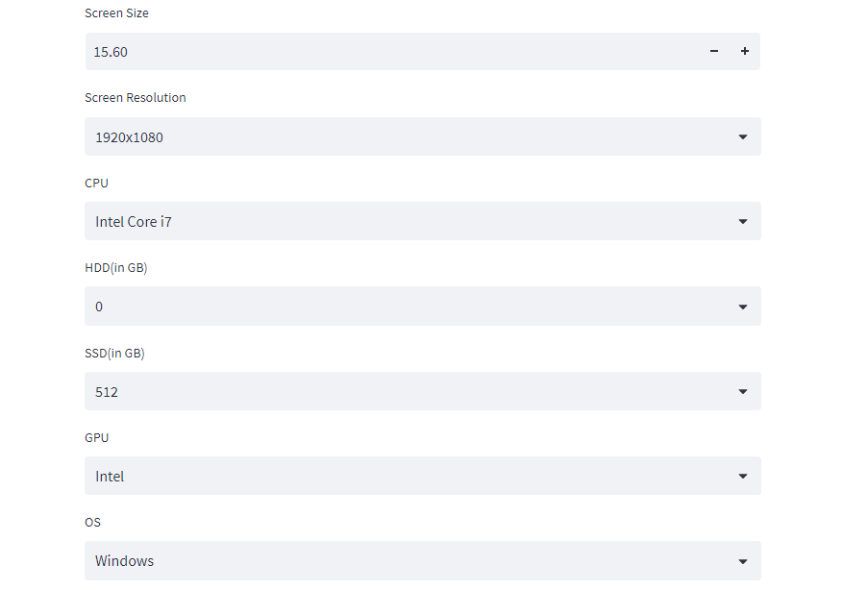
OUTPUTS

Slide 15
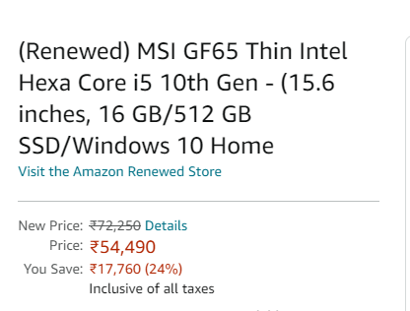
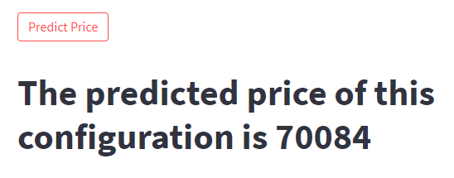
OUTPUTS
Actual Price:
Predicted Price:

Slide 16
CONCLUSION
In summary, our laptop price prediction project successfully employed regression models to accurately estimate laptop prices. By analyzing various laptop features, our models were able to generate reliable price predictions.
This project provides valuable insights for buyers and sellers in making informed decisions and negotiating fair prices. Overall, this project contributes to the field of pricing analysis and assists the buyers in the laptop market with better decision-making.

Slide 17
REFERENCES
https://www.kaggle.com/datasets/muhammetvarl/laptop-price
https://www.visual-design.net/post/top-machine-learning-algorithms-for-regression
https://www.researchgate.net/publication/233843976_Ensemble_Approaches_for_Regression_A_Survey
https://scikit-learn.org/stable/modules/ensemble.html
https://colab.research.google.com/drive/1SQtBNMpYhCDimz2XwwVCerfSCD3jzG5U?usp=sharing

